Slide 1


Orange Fanta
Final Project
SGUP-CT BIDA Junior Data Engineer Programme
22 November 2021

Slide 2
Business Objective 1: Moving from Product-Centric to a more Customer-Centric approach
Every product is available for customers to either solve their problems or fulfill their needs. Every product revolves around its customers and their experiences, and it is the company's responsibility to ensure customers’ satisfaction and expectation level are highly met. Constant and significant efforts are needed by the company based on customer's feedback to provide them with a positive experience.
Customers’ opinions are one of the most important factors that validate important business decisions, catalysing business’ sustainability and growth. These opinions are valuable as they also shape the customer lifecycle. If we do not know what the customers think about our service and products, we would have a lower chance of retaining, delighting and enticing them to make future purchases.

Slide 3
Business Objective 2: Looking for ways to revamp Existing Sales Data Management System
Areas of improvement
Datasets are not aligned to be properly analysed and required to be redesign to reduce complexity and improve efficiency
How to integrate old to new sales data management system
Redesign dataset to remove extra ID and using only one set of unique ID
Making items as the main fact table and setting the grain to be items instead of orders

Slide 4

Problem Statement
1) Database Features/Structure Enhancements (Add/Change)
2) Payment Structure on how payment data is collected
3) Open-ended/Empty Review Comments (Difficult to derive insightful statistics and conclusions)
4) Product Category: Uncategorised ($0.21M)
5) Customer Locations (Delayed Delivery Time/ Negative Review Score): Customer would be upset if waiting time for delivery took too long to arrive)
6) Low Weekend Sales (Introduce Weekend Flash Sales, Giveaways)

Slide 5







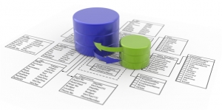
Workflow
Receipt of Dataset > Review & Redesign Dataset > ERD > Data Cleaning > Load Data to Database > Data Manipulation > Data Visualisation > Data Analysis > Recommendations

Slide 6








Data Engineering Toolbox
Collaboration Tools
Microsoft Power BI
Microsoft Excel
Microsoft SQL Server
Microsoft Visual Studio Code
Lucidchart
GitHub
Microsoft Teams
Google Drive

Slide 7

Old Schema

Slide 8
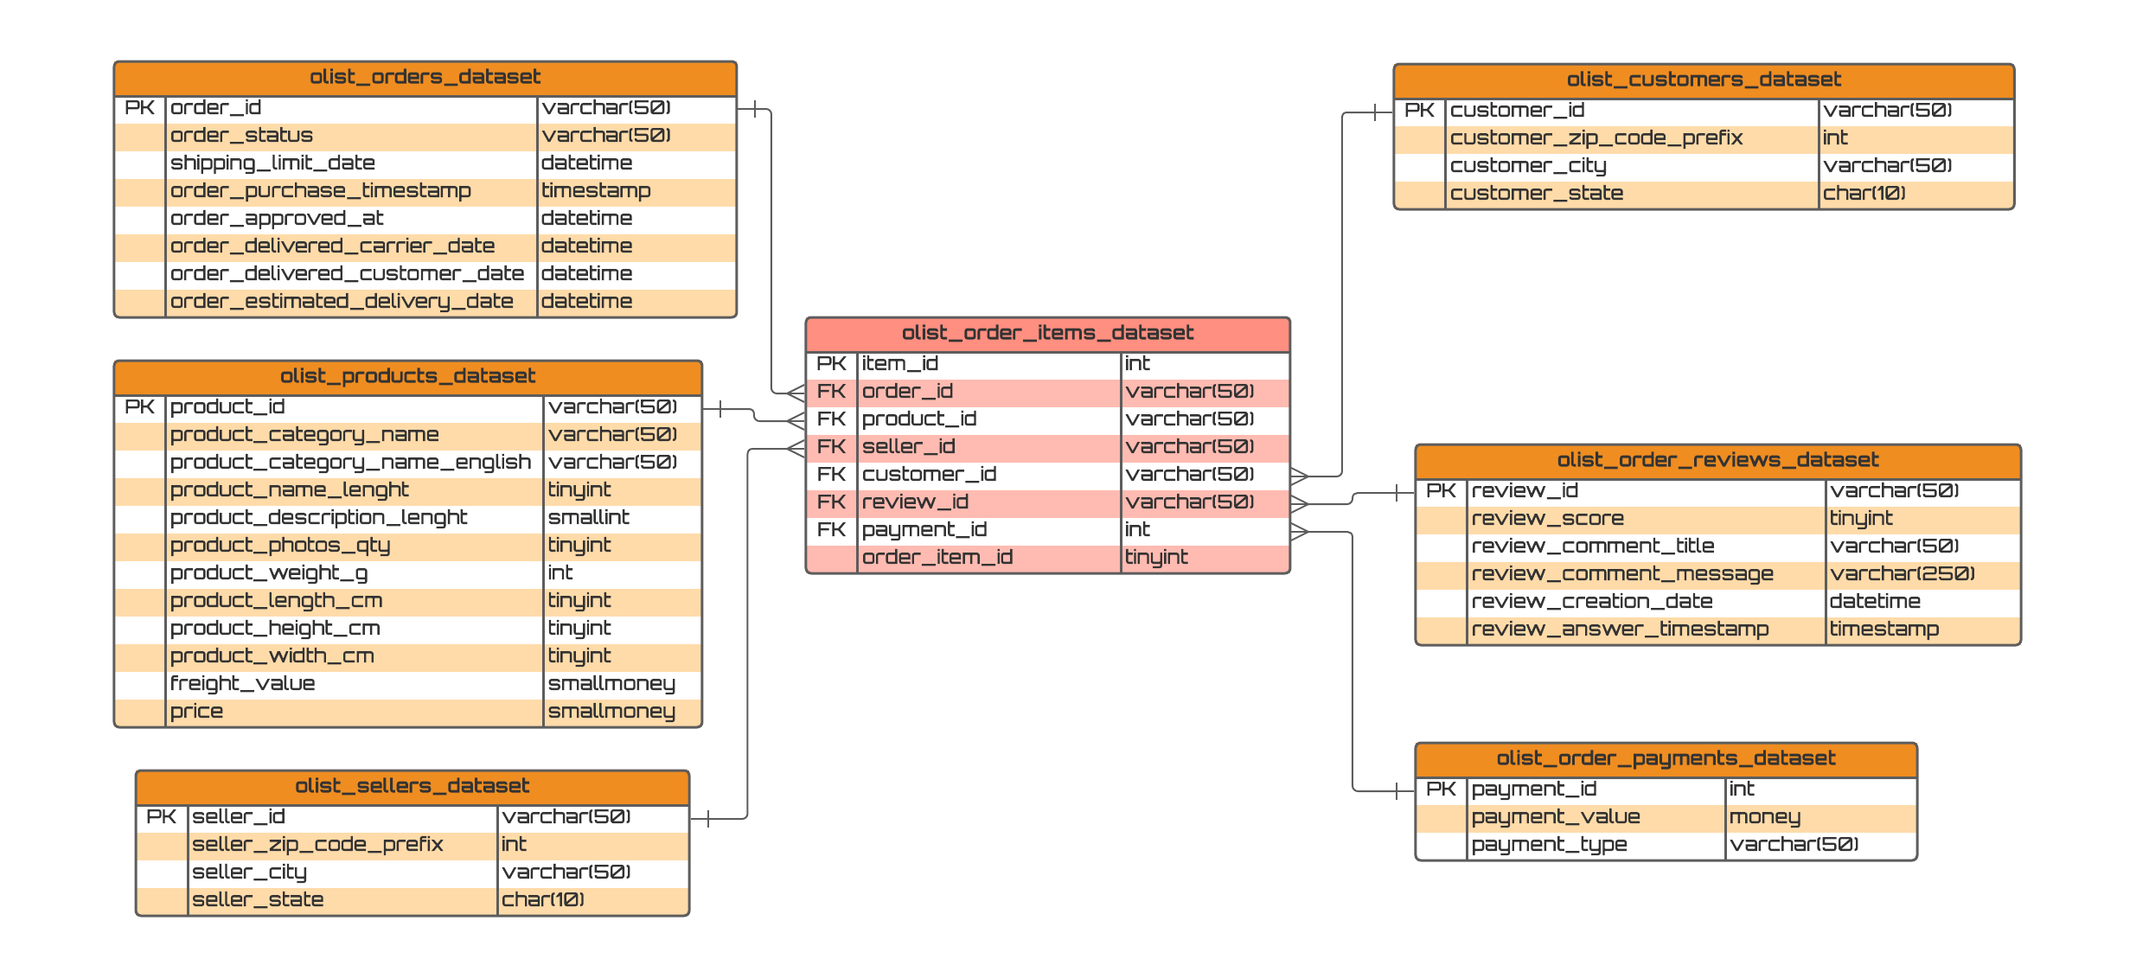
Entity Relationship Diagram (ERD)

Slide 9
Import or Direct Query in Power BI
Pros of Import Mode
All Power BI features are available in Import Mode, like alternative login to the database connection, relationship filtering with “Both” directions …etc.
Faster than DirectQuery Mode, due to the data loaded into the memory, the query calculated from loaded data.
DAX expressions are fully supported.
Single and Both directions in the relation filtering are available.
Cons of Import Mode
Depends on the imported data size, A lot of consumed memory and disk space
On your machine (during the implementation),
On the online/on-prem server (when it published).
The Power BI file size can’t be bigger than 1 GB.
You will get an error If the file size is bigger than 1 GB, in this case, you must have the Power BI Premium that allows having 50 GB file size.
No recent data without a refresh.
Pros of DirectQuery Mode
Always use the current data.
Scalable, No limitation for 1 GB dataset.
Build reports with large datasets.
Cons of DirectQuery Mode
Slower than the Import mode.
Can’t use alternative database credentials.
Can’t combine multiple data sources in Power Query. All must come from a single data source.
No data tab, only report and relation tab.
The “Single direction” is only available. Meanwhile, you can enable “Both direction” for DirectQuery in the preview features.
Time capabilities are not available.
The date columns like Day, Month and Year are not supported.
The returned data to Power BI must be <= 1 million rows.
Many DAX functions are not supported. Meanwhile, you can overcome this limit by Allowing Unrestricted Measure in DirectQuery Mode.

Slide 10

Olist Business Performance Overview
https://tinyurl.com/yjemn3nb
From 2016-2018, Olist has a total number of 96,096 customers and 98,666 orders. The business’ top 5 customers have orders ranging from 24 to 18 orders per customer and top 5 states having customers ranging from 39,974 to 4840 customers per state.
The top 5 product categories are bed_bath_table, sports_leisure, furniture_decor, health_beauty and housewares.

Slide 11
Sales Revenue and Orders Trend
The top 5 best selling categories are bed_bath_table, health_beauty, sports_leisure, furniture_decor and computers_accessories with total orders ranging from 11,115 to 7,827 per category.
Overall, sales revenue is healthy and following an uptrend with infrequent dips.
Monthly and yearly orders are growing stably. We see an increase in orders and sales revenue every year from 2016 to 2018.
Due to limited information provided by the datasets, we are unable to access information on other costs the company has, hence it is not conclusive if the company was financially healthy during the period between 2016 to 2018.

Slide 12
Delivery Trend
We found out that the average, minimum and maximum number of delivery days for an order were 11.55 days, 0 day and 208 days respectively from year 2016 to 2018.
In the line chart, we use data from average actual and average estimated number of delivery days to form two observational lines to compare the overall delivery performance. On average, orders were delivered earlier than expected. Overall, 97.82% of the orders were delivered to the customers.
92.09% of the orders are delivered on time, hence leaving us with less than 8% of delayed orders.
In order to improve our delivery service level, we could set a future target to achieve 95% of the orders to be delivered on time.

Slide 13
Review Analysis
We received a total number of 98,915 customers reviews for score ratings from 2016 to 2018. Based on all the reviews we received, we had an overall performance average of 4.07 out of 5 stars. We assigned by grouping the reviews into 3 categories: 4-5 stars for positive, 3 for neutral and 1-2 stars for negative. Based on the donut chart, out of which, we found out that 76.7% were positive reviews, 15.03% were negative and 8.27% were neutral reviews.
Based on the bar chart, we have most reviews with 5-star ratings and least number of reviews with 2-star ratings.

Slide 14

Recommendations on Areas of Improvement
1) Boost Weekend Sales: Introduce weekend promotions, flash sales and giveaways. Also, revamp customer rewards system with extra points given for weekend purchases.
2) After Sales Customer Satisfaction Survey: Revamp the review system by introducing a new survey format to standardized feedback collection where there will be multiple choice questions, each has a score ranging from 1 to 5 tied to the options. Also, additional questions like age group, gender and product categories’ preferences to improve the quality of feedback and demographics information collected from customers.
3) Shorten Delivery Time: Engage in service of a 3PL (Third-Party Logistics) firm with cross-docking hubs across Brazil at Customer locations (Top 5 Worst Delivery Time): novo brasil, capinzal do norte, adhemar de barros, arace and santa cruz de goias

Slide 15



Thank you!
Any Questions?

